Slide 1
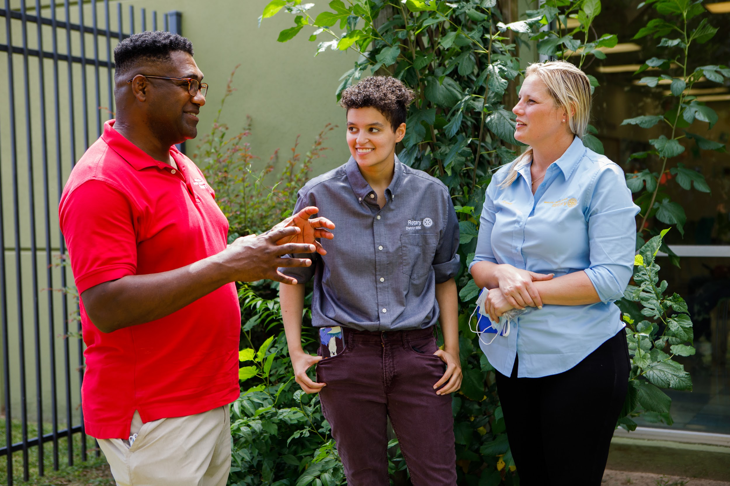

ROTARY BRANDING
WHY IT MATTERS?
Title Page Option
Notes:
Good morning everyone. My name is Hadi Mortada, I am from the Rotary Club of West Ottawa, District 7040 in Zone 28. I am joined here with my colleague, Lisa Leonard, from the Rotary Club of ……… in Zone 32.
Today, we would like to highlight some important items regarding the Brand Center to ensure we comply with Rotary International’s guidelines.
We are people of action! Our brand is more than just a logo; it represents how people and audiences perceive us. We must use the current Rotary logos and be consistent in how we promote our brand in all our communications to build awareness about Rotary.

Slide 2



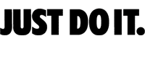
Brands that get attention!
Notes:
Instant Worldwide recognition.
Consistency, in any location or presentation/format the logo looks the same.
We recognize a brand by its name, slogan, logo, or other unique features. Phrases such as "Just do it" are quickly associated with a specific brand (Nike). Think of a popular brand in your country. Can you instantly picture the logo, motto, or other key brand elements? If the answer is yes, that company has done a good job branding itself.

Slide 3
Notes:
These are recognizable brand names and we see them in almost every place we look.
…But they are used under license
And anytime these companies decide to modify their recognizable names all authorized users must comply with the changes!

Slide 4
Rotary International has given us the right to use its recognizable logos.
We must use them as Rotary International asks us to!

Slide 5

How can we do this?

Slide 6
Let’s Start with
THE LEARNING CENTER & BRAND CENTER
Notes:
Let’s start with the learning center and the brand center.
Two useful resources at your finger tips.

Slide 7

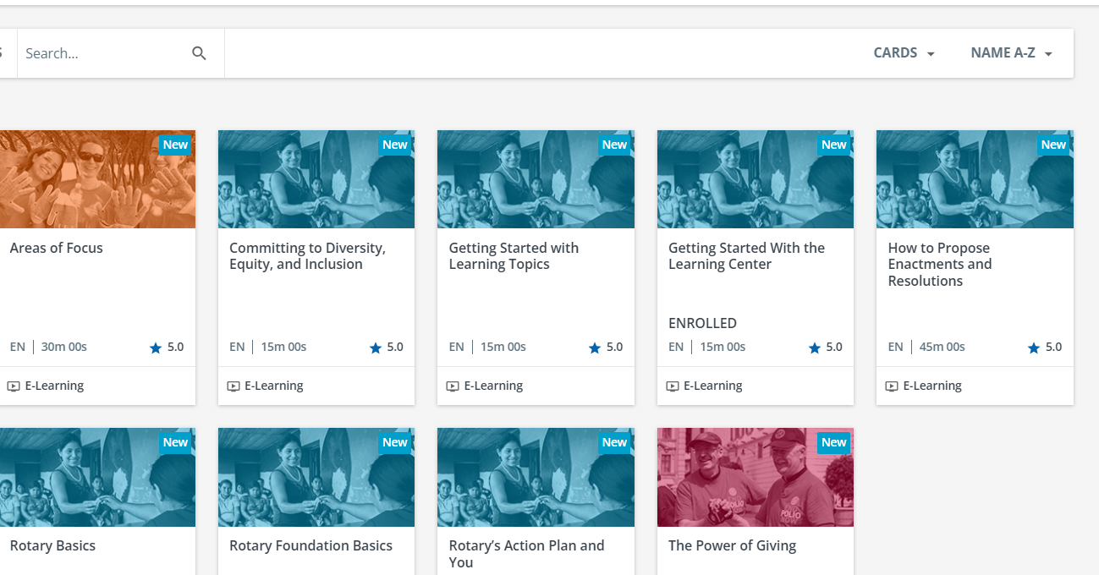
THE LEARNING CENTER
Prepares Public Image committee
Helps solve problems and find answers
You choose the topics and when to learn
Courses are practical and short
Expand Your Knowledge
Notes:
The learning center is where you will find online training modular on a variety of topics.

Slide 8
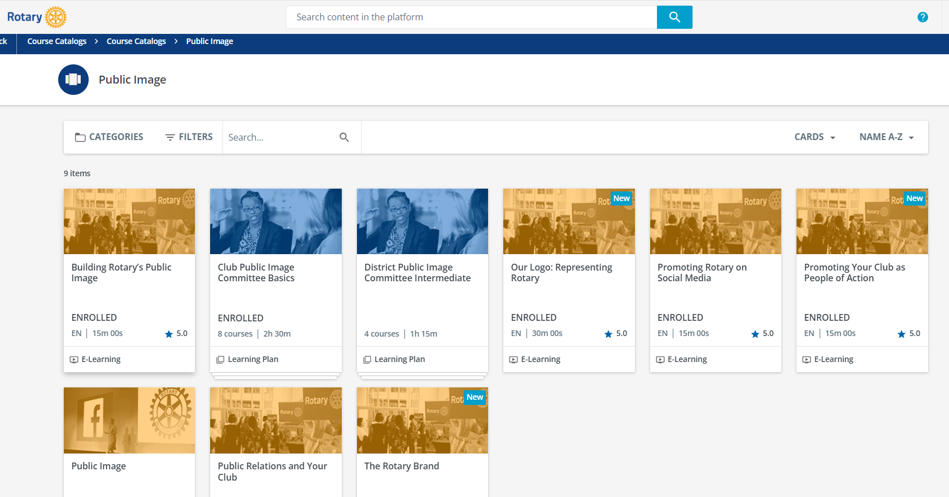
The Learning Center includes
good Public Image information
Notes:
…as you look at the variety of topics you will see a number of public image topics such as using our logo and social media

Slide 9
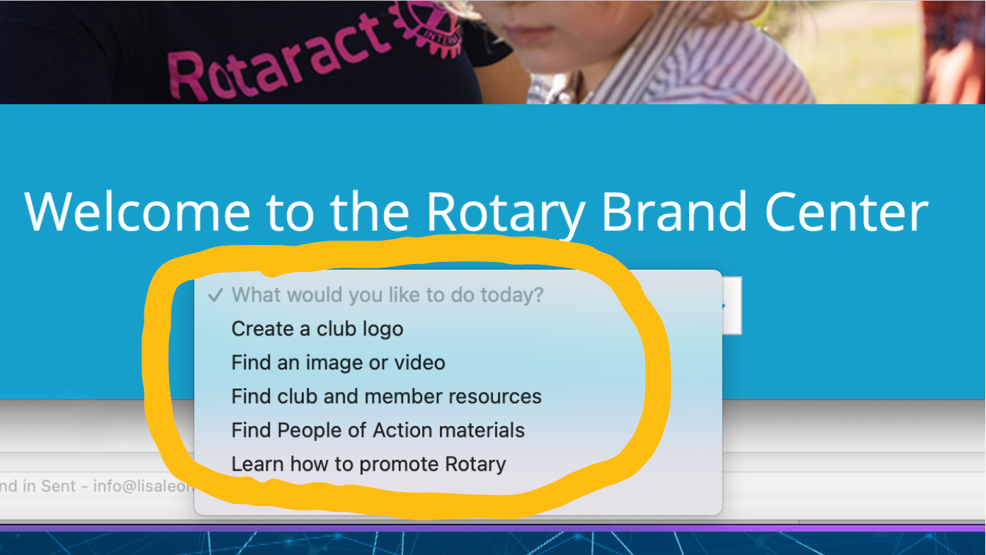
THE BRAND CENTER
Always There to Help You
Notes:
now we are looking at the brand center which is a one-stop shop.
Look at this drop-down menu

Slide 10

THE BRAND CENTER
Find an Image or Video
Caption
Notes:
We are going to talk about logos in a few minutes, but one of the great parts of the brand center is the extensive library of high-quality photograph.

Slide 11
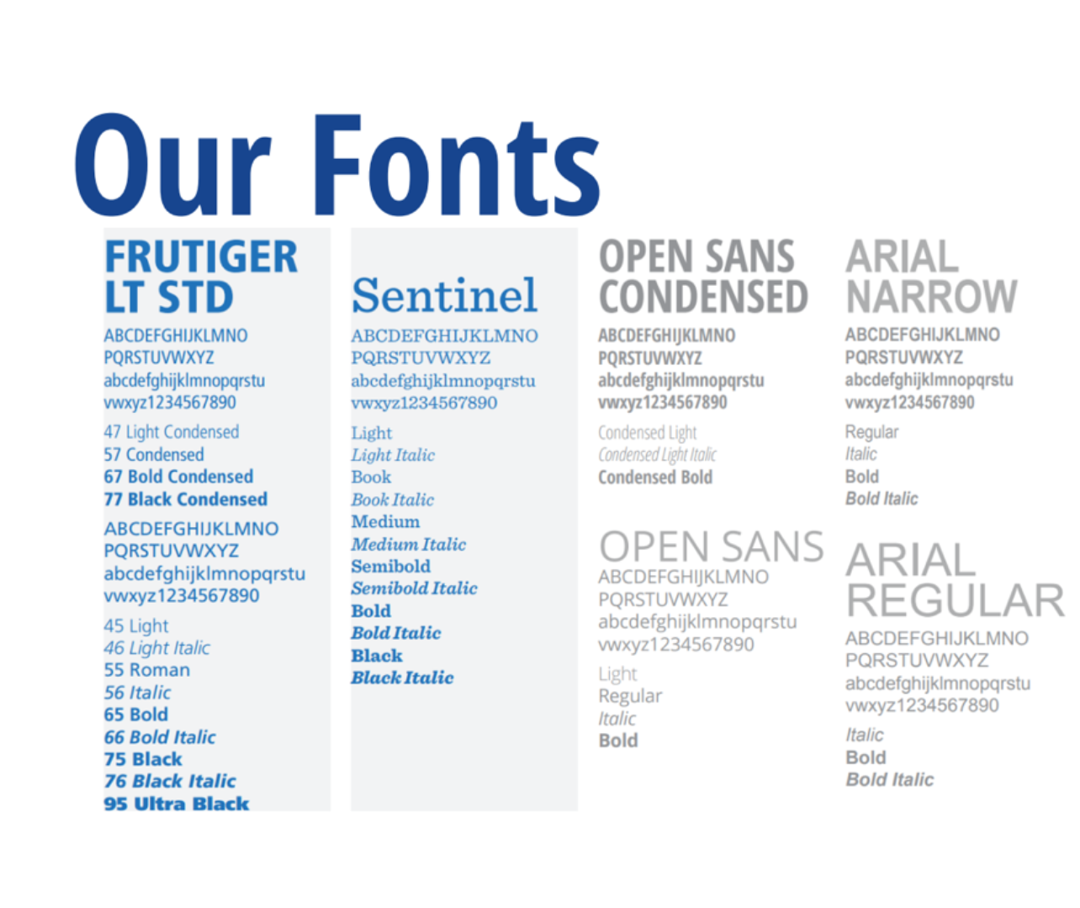
THE BRAND CENTER
Learn Our Fonts
Caption
Notes:
The brand center is where you can learn about the fonts we are able to use.

Slide 12
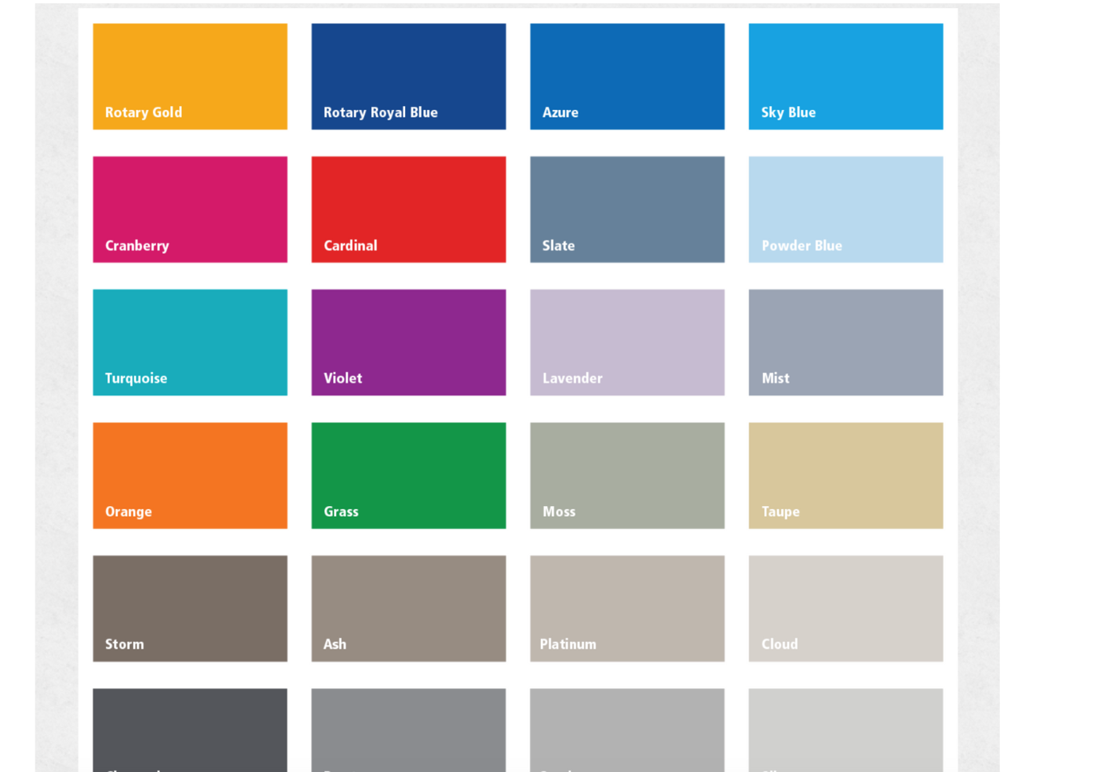
THE BRAND CENTER
Find Our Colors
Caption
Notes:
And the color pallet. More than blue and gold.

Slide 13

WHY USE THE BRAND CENTER?
It will help you create powerful, compelling messages
Strengthens our brand and looks professional
Highlights People of Action as a way of talking about us
Keeps communications consistent
Engages and attracts more members, partners, and donors
Notes:
Why use The Brand Center?
It will help Create powerful, consistent and compelling messages
It Strengthens our brand and looks professional
Highlights People Of Action, that is who we are!
We need to create powerful messages. People’s perception of Rotary comes from their experiences with our clubs and programs, the stories we tell and the images we share. Consistent and compelling communications are key to engaging and attracting more members, participants, donors, and partners.

Slide 14
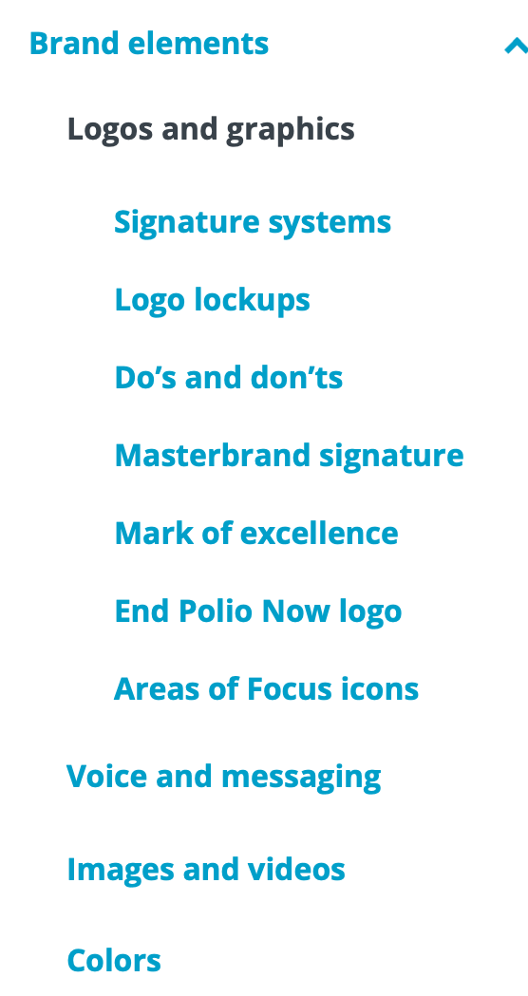
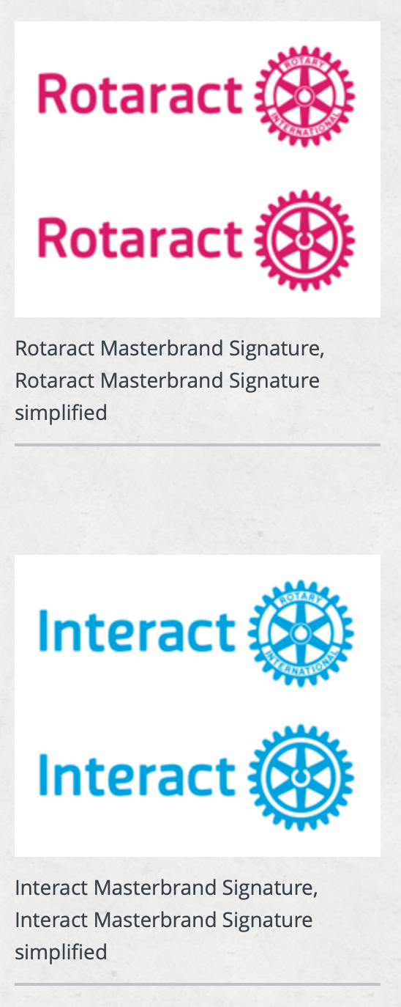


LOGOS
Notes:
We must be consistent with using our master brands. All of this information is available at The Brand Center.
It is a simple and effective tool that helps us create logos for all our events. We can even create business cards!
Look on the left side of this screen

Slide 15



Rotary international logos
Logos du Rotary International
Mark of Excellence
Sceau d'excellence
Masterbrand Signature
Bloc-marque
Masterbrand Signature Simplified
Bloc-marque simplifié
Notes:
Let’s start with some terminology and discuss the foundation of Rotary's logos.
Rotary's official logo is the Masterbrand Signature. It consists of the word Rotary and the Rotary wheel. Those two components are one logo- they should not be separated, stacked, or manipulated. Below the MBS is the simplified logo. Either of these logos can be used as our Rotary logo.
Then, there’s the Mark of Excellence, which is the Rotary wheel on its own. It is always used in combination with the Masterbrand Signature, Secondary logo. Please notice that we don’t offer the simplified logo as the mark of excellence.
These elements are the base of Rotary’s visual identity. Every club, district, and program is to use the Masterbrand Signature its visual identity.

Slide 16
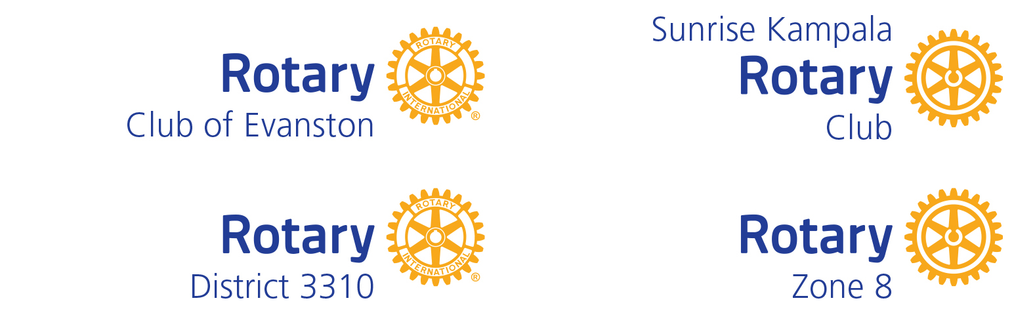
CLUB, DISTRICT & ZONE LOGOS
LOGOS DE CLUB, DE DISTRICT ET DE ZONE
Examples
Notes:
Only Rotary International can use the Masterbrand Signature on its own.
Shown here is how clubs and districts must create and use their own logos. Clubs, districts, multi-districts and zones can only use the Rotary logo with their club, district, or zone name. This applies to Rotary, Rotaract and Interact clubs.
We have regular and simplified examples and clubs can put their name above, below, or above and below the logo depending on how they say their name. Clubs that don't use the word Club when referring to themselves, don't have to include the word "club" in the logo. All logos are unique and should not combine club/district, into one logo.

Slide 17



NEVER OBSCURE THE ROTARY WHEEL,
USE A PARTIAL WHEEL, MANIPULATE THE WHEEL, OR USE THE WHEEL AS
AN OBJECT.
Ne jamais masquer la roue du Rotary, utiliser une roue partielle, manipuler la roue ou utiliser la roue comme un objet.
Notes:
Never obscure the Rotary wheel, use a partial wheel, or manipulate the wheel in any way. Don’t manipulate Rotary’s logo by making it into a pancake, as a bike wheel, or the number zero.

Slide 18



DO NOT USE IMAGES
OR GRAPHICS WITHIN
THE ROTARY LOGO
Ne pas utiliser d’images ou de graphiques à l’intérieur du logo du Rotary.
Notes:
Do not use images or graphics within the Rotary logo. Nike wouldn’t add a tree behind their swoosh, nor should we add anything extra to the Rotary club logo. If clubs embellish the logo, we end up with 36k unique club logos.

Slide 19




RETIRE THE PREVIOUS VERSION OF THE ROTARY LOGO AND ALL UNIQUELY MADE CLUB LOGOS.
Abandonnez la version précédente du logo du Rotary et tous les logos spécifiques au club.
Notes:
Replace your heritage logos with our updated logos. We must tell a consistent story of who we are as members of Rotary, and what we do. That’s our brand. Using the updated brand standards ensures we do that.

Slide 20











INCORRECT USAGE
UTILISATION INCORRECTE
Notes:
The use of various colors, fonts, and sizes, along with the alteration of the Mark of Excellence is a problem. There is no cohesion or unity. Perhaps all of these programs are part of a larger network, but it’s really hard to tell. And that can cause a potential member, donor or partner to doubt if we are an organization they can trust –- to join, to donate money to, or partner with.
We need to be consistent with our logos so we can share a consistent story and message.

Slide 21






CORRECT USAGE
UTILISATION CORRECTE
Notes:
Instead, use the Masterbrand club or district logo system. This ensures that our logo is not only used correctly but when all clubs throughout the world use this system, our brand has more of an impact to people not familiar with Rotary.

Slide 22
34.005. Definition of Rotary Marks
The "Rotary Marks" include all of the below listed word and design marks, as well as their various translations, plus the annual RI Convention logos, the RI Presidential themes and theme logos, among numerous others. These marks are trademarks and service marks owned by Rotary International and used by Rotary clubs, Rotary districts, and other Rotary Entities under guidelines promulgated by the Board, which is entrusted with authority to maintain, preserve and otherwise protect the use of RI's intellectual property marks under section 19.010. of the bylaws of the association. Rotary clubs, Rotary districts, and other Rotary Entities are encouraged to use the Rotary Marks under RI guidelines. However, global ownership rights remain with RI in accordance with the bylaws in order to maintain the integrity and exclusivity of ownership of the Rotary Marks and to preserve and protect them for use by Rotarians throughout the world. (RIB 19.010.) The registration of RI’s intellectual property by RI enhances the association’s exclusive use of the marks and strengthens RI’s position to prevent misuse by other individuals and entities. Rotary Entities and Rotarians are therefore asked not to apply for trademark registration of the Rotary Marks or any translations, abbreviations, or portions thereof.
Rotary Code of policy
Code of Policies du Rotary
Notes:
Now that I've provided you with the foundation of the importance of using our logos correctly, I'd like to disuss the equally important topic of ensuring the Rotary name is used correctly. <Read the highlighted sections.>

Slide 23
subhead
What is a trademark?
Qu'est-ce qu'une marque déposée ?
Notes:
What is a trademark?
A trademark is any word, name, logo, symbol, slogan, motto, or phrase that identifies goods or services and the origin of those goods or services. A trademark is an enduring business asset that prevents consumer confusion.
A brand is a combination of the visual representations, values, and attributes associated with an organization. Rotary's brand can be recognized not only through the use of our name and logos but also in the style of club meetings and the use of phrases such as "People of Action."
Trademarks provide legal protection to the Rotary brand, including our logos, the name Rotary, and other common Rotary phrases and images.

Slide 24
subhead
Proper Use of Rotary Name and Logos
Utilisation correcte du nom et des logos du Rotary
Notes:
How do we apply what we've learned about trademarks to Rotary?

Slide 25

Rotary Family Picnic
?
Pícnic familiar en Rotary
Notes:
If clubs or districts use just "Rotary," "Rotaract," or "Interact," that can imply that the event or project is an event or project of Rotary International. *click Clubs can use the "Rotary Club," "emark in the name of their event or project if it includes their specific club identification and if the club is in full control of the event or project. Districts and zones can use "Rotary" with their district or zone number.

Slide 26

Rotary Club of Edina
Annual Family Picnic
Rotary Family Picnic
Notes:
If clubs or districts use just "Rotary," "Rotaract," or "Interact," that can imply that the event or project is an event or project of Rotary International.
Clubs can use the "Rotary Club," "Rotaract Club," or "Interact Club" trademark in the name of their event or project if it includes their specific club identification and if the club is in full control of the event or project. Districts and zones can use "Rotary" with their district or zone number.

Slide 27

Rotary Hospital
Hospital de Rotary
?
Rotary Club of Evanston Hospital
Hôpital du Rotary club d’Evanston
Notes:
Instead of: Rotary Hospital or Rotary Club of Evanston Hospital
Name it: A title that doesn't contain "Rotary" or "Rotary Club." The name "Rotary Club of Evanston Hospital" wouldn't adhere to our brand guidelines because the club doesn't have full control of the hospital. * Click
Instead, when you dedicate a place or object in the community to honor your club, use signs that state the name of the club (with the correct club logo!) and the relationship the club has with the owner, city, or local organization, such as a gift from the Rotary club.

Slide 28


Rotary Hospital
Hospital de Rotary
Rotary Club of Evanston Hospital
Hôpital du Rotary club d’Evanston
Notes:
Instead of: Rotary Hospital or Rotary Club of Evanston Hospital
Name it: A title that doesn't contain "Rotary" or "Rotary Club." The name "Rotary Club of Evanston Hospital" wouldn't adhere to our brand guidelines because the club doesn't have full control of the hospital. * Click
Instead, when you dedicate a place or object in the community to honor your club, use signs that state the name of the club (with the correct club logo!) and the relationship the club has with the owner, city, or local organization, such as a gift from the Rotary club.

Slide 29
subhead
Rotary Marks on Merchandise
Les produits dérivés du Rotary
Notes:
Protecting the trademark also applies to good and merchandise

Slide 30
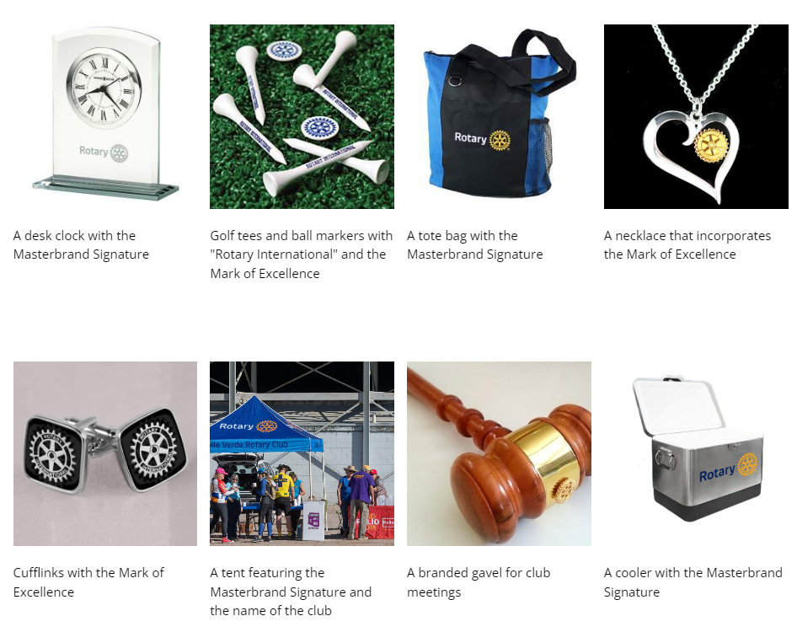
Licensing and merchandise
OCTROI DE LICENCES ET PRODUITS DÉRIVÉS
Notes:
Rotary has more than a hundred licensed vendors who offer various kinds of merchandise that's already branded with the Rotary Marks. These vendors are trained to use the Rotary Marks in compliance with our branding and licensing policies.
When a vendor produces Rotary-branded merchandise, their use of Rotary Marks may differ from when a club or member uses them. This is because reproducing Rotary Marks on different items needs to account for different manufacturing processes, space, and visual appeal. We work closely with vendors on those uses.
Although you are always encouraged to use an RI licensed vendor, there is an exception process in place if you're unable to use a licensed vendor for some reason. To apply for the exception, please contact rilicensingservices@rotary.org or save this link. https://rotary.qualtrics.com/jfe/form/SV_3PmWKWoW1NYT1pI

Slide 31

Talk to your clubs and
guide them in promoting
this event in your
local community.
What are you doing?
Que fais-tu?
Parlez à vos clubs et les guider dans la promotion cet événement dans votre communauté locale.
Notes:
What are your clubs and districts doing to talk to your communities about World Polio Day?
Take advantage of this event and show your communities what Rotary has been doing for over 35 years to eradicate Polio.
Rotary International will provide graphics & resources to help you promote World Polio Day
Register for the webinar on October 2nd. For tips on how to create a fundraiser during this event. Registration available on the Zone website

Slide 32


1
Visit and use the Learning Center and Brand Center
Review your website & promotional materials to ensure brand compliance
CALL TO ACTION
APPEL À L'ACTION
2
Visitez et utilisez le Learning Center et le Brand Center
Revise votre.

Slide 33
Lisa Leonard
Zone 32
Lisa@LisaLeonardVoice.com
Hadi Mortada
PDG D-7040-Zone 28
hmortada@aol.com
Always share your contact information
Partagez toujours vos coordonnées

Slide 34

Communication & RESOURCES
COMMUNICATION & RESSOURCES
Notes:
** Possibly delete if we don’t have time.
Let's take a moment to discuss how you will support conversations centered around protecting Rotary's trademark.

Slide 35

QUESTIONS

